Slide 1

The Power of a Pathway
A VISION & STRATEGY FOR ONLINE EDUCATION · UNIVERSITY OF ARIZONA
Bettyjo Bouchey
Notes:
Good morning, everyone! Quick pulse check: as you came into the Zoom and into the room today in-person, what number are you—1 to 5—with 5 meaning "I'm ready to take on the world" and 1 meaning "more coffee, please”. I’m a big 5 and so grateful for your time today.

Slide 2
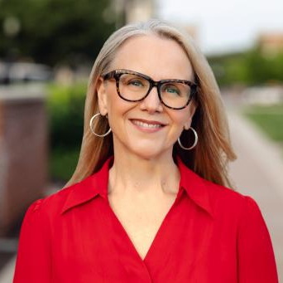
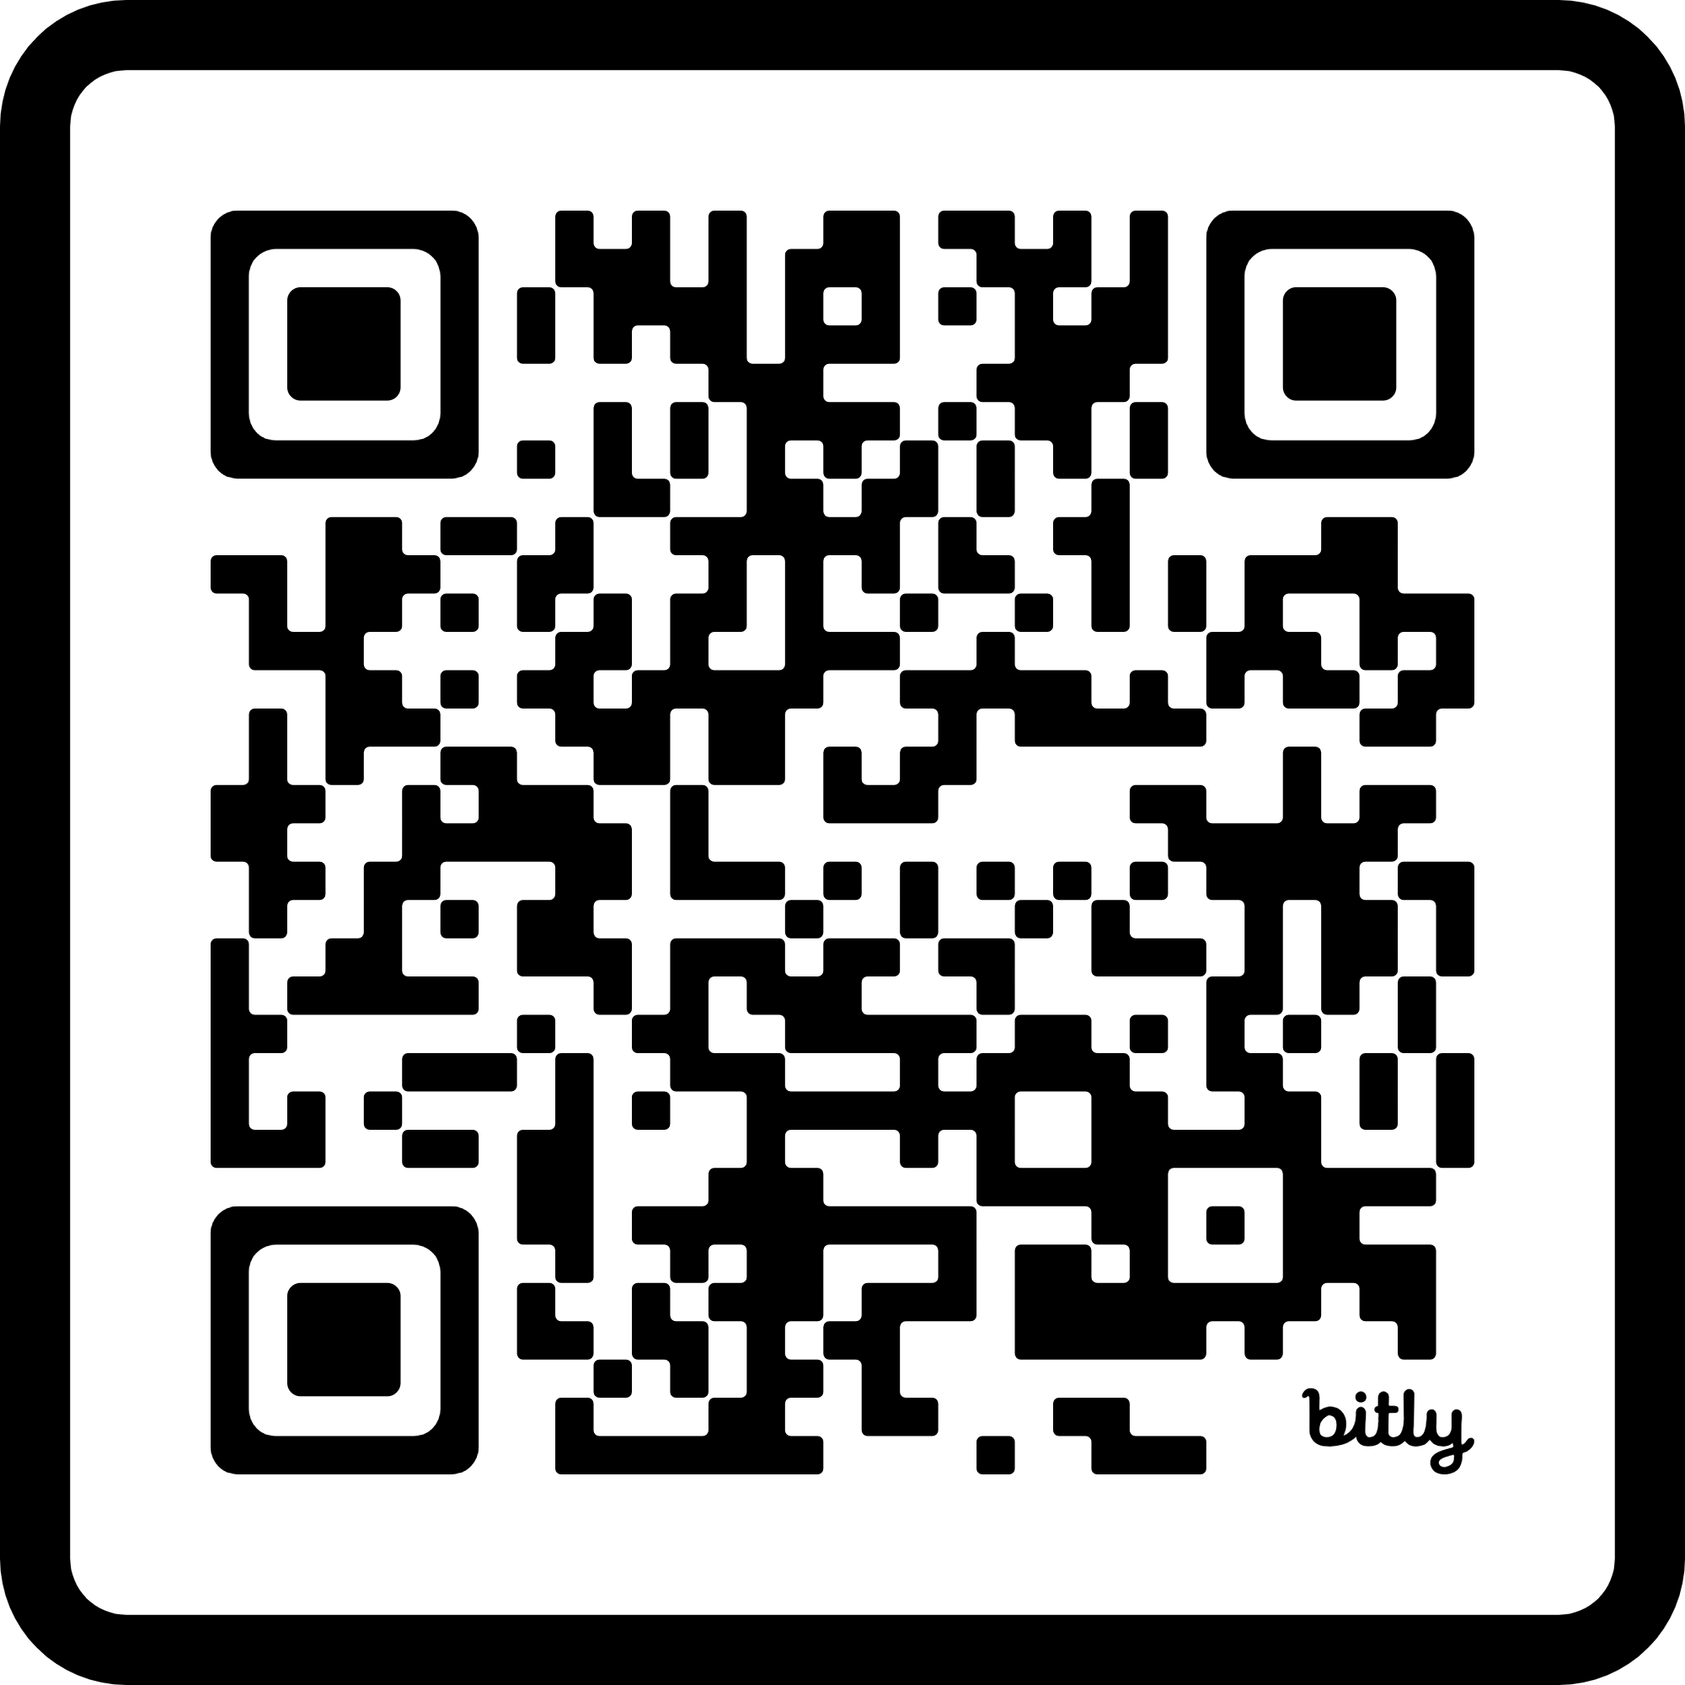
ABOUT ME
Bettyjo Bouchey, Ed.D., MBA
Candidate · Senior Vice Provost, Online Education · University of Arizona
I'm a first-generation college student whose life was changed by education, and I've spent nearly two decades making that same possibility real for others online. I've led every corner of the online campus, always informed by heart and evidence.
CURRENT ROLE
Chief Officer, Professional [Online] & Continuing Education, University of Vermont w/ a broad portfolio
WHAT I DO
Online & digital strategy, learner pathways, and innovation
EDUCATION
Ed.D., Northeastern · M.B.A., Rensselaer · B.A., Albany
BEYOND THE ROLE
Storyteller, mom, wife, daughter, sister, and dog lover
Notes:
My name is Bettyjo Bouchey and I am a candidate for the Senior Vice Provost of Online Education and it’s a privilege to be here today. By way of background, I’ve put some highlights on this slide, and provided a QR code that will take you to my website where I have stored a copy of this presentation for you, and then you can see more about my background as well.

Slide 3
How I'll Approach This
Co-construction over prescription: understand the landscape first, then chart the path…together.
01
02
03
Understand the Landscape
Co-Construct
Then Chart the Path
Listen first. Map the systems, the people, and the work already underway before proposing anything.
Build with the people closest to the work - with, never for. The best answers are shared answers.
Sequence change from real understanding and the learner's experience, not from an org chart.
A FIRST PASS: OFFERED IN THAT SPIRIT
The ideas ahead are early thinking. There is already excellent work underway in some of these areas and/or sound reasons not to pursue others, and I'll be thrilled to discover that and figure out the right path forward, together.
Notes:
I truly appreciate the prompt and how important it is as this new leader joins the team. That said, I also wanted to say upfront that the way I would normally approach putting together a path forward is a bit more authentic and grounded in the folks closest to the work. There is likely already excellent work underway in the areas I will talk about...and I will be thrilled to discover that and map a path forward together.

Slide 4

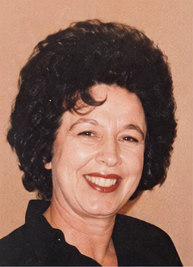
What’s in a Name?
Two women. Neither set foot in a college classroom, yet I carry their names into rooms they never imagined (thank you).
Margaret
Josephine/a
Grandma Betty
Grandma Jo
Betty + Jo → Bettyjo.
Education is the pathway that carried their names forward.
Notes:
So, let’s get back to my first pass of Vision and Strategy for Online Education at UA. On my background slide in the “beyond the role” section, I lead with storyteller. Storytelling is how I make sense of the world and I’ll be using a story to frame our conversation. Again, my name is Bettyjo — and it isn't an accident. It is a promise, stitched together over time. I want to tell you about Josephina who changed her name to Josephine when she came to the US — we called her Jo — and Margaret – we called her Betty. I simply called them Grandma. Jo didn’t go to high school and Betty was married by her Senior year. Neither of them attended college. Life handed them circumstances that closed those doors before they could even reach for the handle. And yet, every time I walk into a boardroom, a lecture hall, or a meeting with university leadership like you, I carry both of their names with me — literally. Bettyjo is Betty and Jo, together. I am the proof of what becomes possible when a pathway opens, even 2 generations later. This is why I do this work. Education is not an abstraction to me. It is the pathway that let their names walk into rooms they never got to enter themselves.

Slide 5
A Pathway Changes Lives
What happened for one family, one generation at a time, UA can now create at-scale.
01
02
03
04
Opportunity
Education
Possibility
Impact
A door opens
It is taken up
Horizons widen
Generations change
A pathway changed my family’s story.
The University of Arizona can build thousands more, on purpose & at-scale..
Notes:
A pathway changed my family’s story. It started with a single opportunity that someone reached out and took — an education that widened what the next generation could even imagine, which in turn created impact that rippled across all of us who came after. That is the sequence: opportunity, education, possibility, impact. Here is the thing I want you to hold onto: what happened for my family by luck and persistence, one person at a time, is exactly what a great public university can engineer on purpose — at scale. U of Arizona has the reach, the mission, and the platform to turn a personal story into a system. That is the opportunity in front of us.

Slide 6
This Moment at University of Arizona
The role is integration. The larger opportunity is to build a future-focused pathway system.
Arizona Online
UAGC
Research
Future-Focused Pathway System
HSI / Land Grant
Community & Tribal Partnerships
moment → movement
Notes:
Here’s what I see at U of Arizona right now when thinking about online. We have Arizona Online. We have UAGC. We have a top-tier research enterprise. We are a Hispanic-Serving Institution and a land-grant university. And we hold deep community and tribal partnerships. Individually, each of these is a real asset. My immediate role is integration — getting these pieces to work together instead of in parallel. But the larger prize is bigger than integration. It is to connect all of these into a single, future-focused pathway system, with the learner at the center. When these stop being separate boxes on a slide and start being one connected ecosystem, that is when this moment becomes a movement.

Slide 7
The Strategic Thesis
ONLINE IS NOT A DELIVERY MODE - IT IS CONNECTIVE TISSUE
Access
Academic Quality
Research Strength
Workforce Need
Community Impact
Online is connective tissue of the university (not a side channel): moving opportunity,
knowledge, and talent to wherever they are needed
Notes:
Here is my central thesis about what might be possible at UA. Online is not just a delivery mode — it is not simply ‘the same courses, but on a screen.’ Online can be the connective tissue of the university. It is the layer that can bind together five things we too often treat separately: access, academic quality, research strength, workforce need, and community impact. When you view online this way, it stops being a side channel and becomes a circulatory system — moving opportunity, knowledge, and talent to wherever they are needed. Everything else I share today flows from this one idea.

Slide 8
Five Big Bets
THE WAGERS THAT TURN THE THESIS INTO A STRATEGY - LEVERAGING STRENGTHS
01
02
03
04
05
Lifelong Learner Ecosystem
Tribal Futures through Sovereignty, Place, and Partnership
Research-Powered Pathways
One Arizona Journey
Arizona Horizon
A disclaimer: we might dream up different and better bets, together.
Notes:
So how do we act on that thesis? I want to put five big bets on the table — five wagers I believe U of Arizona is uniquely positioned to make. Bet one: Arizona’s Lifelong Learner Ecosystem. Bet two: Tribal Futures through Sovereignty, Place, and Partnership. Bet three: Research-Powered Pathways. Bet four: One Arizona Journey. And bet five: Arizona Horizon. I call them bets deliberately because they require conviction and investment before the payoff is guaranteed. But each one is grounded in a real strength UA already holds. Over the next several slides I’ll walk through each bet and the signature initiative that might bring them to life.

Slide 9
BET 01
Arizona’s Lifelong Learner Ecosystem
Signature Initiative Arizona Pathways Network
TALENT IS EVERYWHERE. PATHWAYS ARE NOT.
K–12
Community College
Undergrad
Graduate
Professional
Alumni
Multiple entry points, one connected network, and a reason to return at every stage of life.
Enroll once. Belong for a lifetime.
Notes:
Big bet number one: bring together Arizona’s Lifelong Learner Ecosystem, delivered through a signature initiative I call the Arizona Pathways Network. My starting belief here is simple but urgent: talent is everywhere, but pathways are not. Right now we tend to treat a learner as someone who shows up once, at eighteen, for four years. That model misses most of a person’s life. The Pathways Network reimagines the university as something you can enter from many points — K–12, community college, as an undergraduate, a graduate student, a working professional, or as an alum coming back to reskill — and it keeps you connected across all of them. Enroll once, belong for a lifetime. Arizona should become visible in learners' lives long before they apply and long after they graduate. That is the positioning I am arguing for here.

Slide 10

LAND ACKNOWLEDGEMENT
Honoring the land and its original peoples
We respectfully acknowledge the University of Arizona is on the land and territories of Indigenous peoples. The University strives to build sustainable relationships with sovereign Native Nations and Indigenous communities through education offerings, partnerships, and community service.
22
O’odham & Yaqui
federally recognized tribal nations across Arizona
the peoples whose ancestral homelands include Tucson and the University
Notes:
I'd like to acknowledge the Indigenous peoples connected to this land. Rather than read a statement, I invite us to hold a moment of gratitude for those who came before us and whose relationship to this place continues today. The full acknowledgment is provided on the screen

Slide 11
BET 02
Tribal Futures Through Sovereignty, Place, and Partnership
Signature Initiative Arizona Tribal Futures Network
CO-CREATED FUTURE: BUILT WITH, NEVER FOR.
Tribal Microcampuses
Workforce development pathways
Digital inclusion and broadband access
Dual enrollment and transfer pathways
Moving the university closer to communities: a place-based pathway system built with
Arizona’s Tribal Nations, never delivered to them.
Notes:
Big Bet Two refines how the university partners with Arizona’s tribal nations in collaboration with the Office of Native American Advancement and Tribal Engagement. This is about deepening UAs existing partnershps. I’ve named it Tribal Futures Through Sovereignty, Place, and Partnership, anchored by the Arizona Tribal Futures Network. The core idea is to move the university closer to communities rather than asking communities to come to us. It’s a place-based pathway system with additional tribal microcampuses, deeper digital infrastructure, workforce pathways, and university access, modeled on the Pascua Yaqui microcampus and built with tribal nations, never delivered to them. The goal isn’t to deliver education to tribal nations. It’s to build educational, workforce, and leadership capacity with them.

Slide 12
BET 03
Research-Powered Pathways
Signature Initiative Grand Challenge Pathways
CONNECT ARIZONA’S RESEARCH STRENGTHS TO LEARNER OPPORTUNITY.
Water
Space
Health
AI
Climate
Each grand challenge becomes a learning pathway where students work on the problems that define the future.
From the lab to the world through the power of online.
Notes:
Big bet number three: Research-Powered Pathways, through what I’d call Grand Challenge Pathways. Univ of Arizona shouldn't build online solely around market demand (though, we will certainly do that too!). But we should also be acknowledging that UA is a research powerhouse in areas that map almost perfectly onto the defining challenges of this century — water, space, health, artificial intelligence, and climate. I want to acknowledge that AZO is doing some of this already, perhaps quietly and I’d like to be loud and proud about this. The idea is to turn each grand challenge into an cohesive learning pathway, so a student isn’t just reading about the future — they’re working alongside faculty on the problems that will define it. That connection between research strength and learner opportunity is a competitive advantage very few universities can offer, and online is how we scale it beyond the lab.

Slide 13
BET 04
One Arizona Journey
Signature Initiative The Learner Operating System
ONE UNIVERSITY: NOT A MAZE OF DISCONNECTED OFFICES
Explore
Apply
Learn
Graduate
Career
Return
the journey begins again
The innovation isn’t any single stage: it’s the operating system that surrounds the learner at every one.
An invisible infrastructure wrapped around the learner making their journey seamless and cohesive.
Notes:
Big bet number four is One Arizona Journey, powered by what I think of as a learner operating system (and I can’t take too much credit for this one since it is literally the job~). Ask a student to describe their experience of a large university and you’ll often hear the same thing: it feels like a maze of disconnected offices — admissions here, advising there, financial aid somewhere else, the career center as an afterthought. Students should experience one university, not a dozen. Students shouldn't need to understand our organizational chart to succeed, and the university should feel coherent no matter where a learner enter because the journey is continuous: explore, apply, learn, graduate, launch a career, and then return to learn again. The real innovation isn’t any single stage — it’s the operating system wrapped around the learner that makes the whole thing feel seamless. That’s the invisible infrastructure that turns a collection of services into a relationship. Enroll once…belong for a lifetime.

Slide 14
BET 05
Arizona Horizon
Signature Initiative The Futures & Foresight Studio
READINESS IS A DISCIPLINE: WE SHAPE THE FUTURE, NOT JUST PREDICT IT.
Space Economy
Longevity
The Future of Work
Climate Adaptation
Human + Machine
Scanning the signals on the horizon so UA and our learners are ready and helping to shape what arrives.
Notes:
Big bet number five is Arizona Horizon — a futures and foresight capability for the university, a kind of studio for thinking ahead. Here’s the mindset I want to instill: futures thinking is not about predicting the future, because no one can. It’s about readiness. Any pickleball players in the audience…let’s be in our ready position — scanning the signals already emerging on the horizon and preparing for a range of what might come, several futures might come to light. Signals like the reshaping of work by AI, human longevity, climate adaptation, the space economy, and the blending of human and machine. A great university shouldn’t just react to these shifts — it should help shape them, and prepare learners to lead through them. Arizona Horizon is how we make foresight a discipline rather than a guess. The Arizona Horizon will help us shape both our Research Powered Pathway programs, and also our workforce-aligned one – it becomes a force multiplier for our responsiveness.

Slide 15
What Success Looks Like
If these bets pay off, here is what changes for the people we serve (students, faculty, communities, and the institution).
Access
Excellence
More learners engage with us from every ZIP code, tribe, and stage of life.
Quality rises with scale; online strengthens the whole institution.
Impact
Belonging
Research and workforce needs connect directly to opportunity.
Every learner feels part of One UA and keeps coming back.
All underpinned by a sustainable financial model
Notes:
So what does success actually look like? I hold it to four outcomes. Access: more learners engage with us — from every ZIP code, every tribal nation, and every stage of life. Excellence: quality goes up, not down, as we scale, because online strengthens the institution rather than diluting it. Impact: our research strengths and real workforce needs connect directly to learner opportunity. And belonging: every learner feels like part of one Arizona, and that sense of belonging is what brings them back again and again. If we're successful: Students see clear pathways, Faculty see stronger support, Communities see deeper partnership, Arizona sees greater impact. Access, excellence, impact, belonging — for students, for faculty, for communities, and for the institution as a whole. That is the scoreboard I want us judged against. Mention Financial Sustainability

Slide 16
The Strategy in One Sentence
“
Online should be the connective tissue between access, research strength, workforce need, and community impact.
— a single line, a single breath
Notes:
If you forget everything else I’ve said today, I want you to keep one sentence with you. Online should be the connective tissue between access, research strength, workforce need, and community impact. That’s the whole strategy in a single line. Every big bet, every initiative, every dollar and every hire should be tested against it: does this help online do that connecting work? If yes, we lean in. If no, we ask why we’re doing it. A strategy you can’t say in one breath isn’t a strategy — it’s a wish list. This one, I can say in a breath, and so can you.

Slide 17
The Power of a Pathway
Where we began and where a pathway can lead, generation after generation.
Betty & Jo
Bettyjo
Today’s Learners
Their Families
Arizona’s Communities
A pathway opened for two women who never got to walk it. Now we can open thousands more and expand what’s possible across generations.
Notes:
As I bring us to a close, let me bring us back to where we started — to Betty and Jo. Two women who never got to walk the pathway themselves, but who made sure the next generation could. Their names became mine: Bettyjo. And the reason this vision matters to me is that I know, personally, what happens when a pathway opens. It doesn’t change one life — it changes a family, and then a community, across generations. That’s the through-line from Betty and Jo, to me, to today’s learners, to their families, to communities all across Arizona. Everything I’ve laid out today — the thesis, the five bets — is really just a way to open that pathway for far more people than luck ever could. That is the power of a pathway.

Slide 18
Questions & Conversation
LET’S BUILD THE PATHWAY — TOGETHER
Notes:
I’ll stop there and open it up. This is the part I look forward to most, because a vision only gets stronger when it meets other people’s questions, doubts, and ideas. So let’s talk. I’d love to hear where this resonates, where you’re skeptical, and where you see pathways I haven’t named yet. Thank you — for your time, and for caring about the learners on the other end of all of this.

Slide 19
Supplemental Slides

Slide 20
Program Portfolio Analysis
A two-step read on the online portfolio: where each program plays today, then how we grow it.
STEP 1 · THE GROWTH SHARE MATRIX
STEP 2 · PRODUCT & GROWTH STRATEGY
High ▲
Stars
Online Nursing & Health Sciences
Question Marks
AI & Data Science micro-credentials
Market Penetration
Grow enrollment and share within existing programs and markets.
Market Development
Take proven programs to new learners — tribal, professional, out-of-state.
MARKET GROWTH
Mature Leaders
Online Business & Education degrees
Pets
Legacy niche certificates
Product Development
Build new programs for current learners, like Grand Challenge pathways.
Low ▼
High ◂ RELATIVE MARKET SHARE ▸ Low
Diversification
New programs for new markets; differentiate on research and pathways.
Placements shown are illustrative, for strategic discussion.

Slide 21
Priority Programs to Analyze
Where Arizona Online and UAGC overlap: the duplications to resolve first.
Highlighted programs are offered by both units.
Area | Arizona Online | UAGC
Business | BSBA, MBA, Accounting, Finance, Marketing, MIS | BBA, Business Leadership, Finance, Marketing, Operations, MBA
Psychology | BA Psychology | BA Psychology, MA Psychology
Criminal Justice / Security | Criminal Justice, Cyber, International Security | Criminal Justice, Homeland Security
Education | Educational Leadership, Special Education programs | Large education portfolio
Health Administration | Healthcare Management, Public Health | Healthcare Administration, Health Services
Information Technology | Computer Science, Cybersecurity, Data Science | Information Technology, Cyber/Data Security

Slide 22
Making Sense of the Portfolio
A potential framework: three portfolios, each with a distinct role in UA’s online strategy.
PORTFOLIO 1
PORTFOLIO 2
PORTFOLIO 3
Arizona Signature
Workforce Advancement
Pathway Portfolio
Programs only UA can credibly deliver.
Primarily workforce-oriented, not always degrees.
Cross-enterprise.
Water Futures
Leadership
Dual enrollment
Space Futures
HR
Community college transfer
Quantum
Project Management
Certificates
Cyber
Human Services
Stackable credentials
AI
Education
Tribal Nation pathways
Indigenous Governance
Health Administration
Employer pathways
Climate Resilience
Innovative Business

Slide 23
Integrating Arizona Online & UAGC
My approach: start with reality and the learner, not the org chart.
01
02
03
Listen & Map Reality
Clarify the Target Operating Model
Sequence the Change
Systems, workflows, duplications, pain points, and cultural narratives.
What is centralized, what stays college-facing, and what success looks like.
Quick wins now, paired with a multi-year infrastructure roadmap.
“
I would not begin with org charts. I would begin with the student lifecycle, the college-partner experience, the core systems architecture, and the patterns of friction and then build a phased operating model that improves service and accountability while preserving continuity.

